Slide 1
Lecture
Access – Queries

Slide 2
What’s a Query?
A question you ask a database
  ie: “Who are my Stockton customers?”
  ie: “How much did Bob sell on the 14th?”
A saved set of filters, sorting, and other specifications for later use in a form, report, or to make a new table

Slide 3
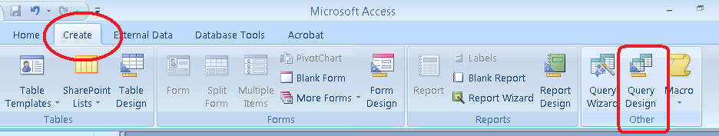
Creating a Query
Create Ribbon
Query Design

Slide 4
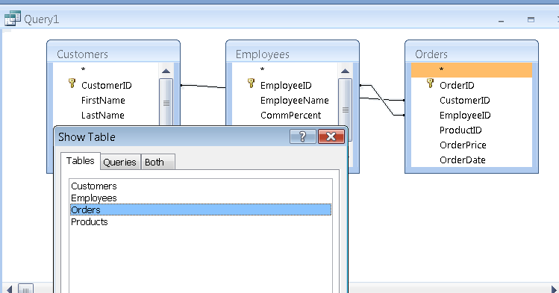
Adding Tables to your Query

Slide 5
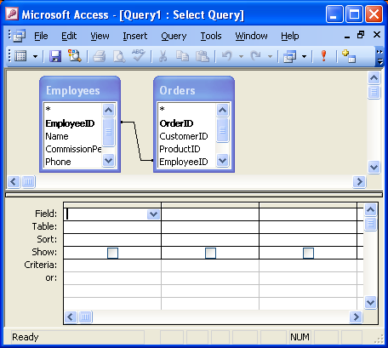
Adding Tables to your Query
note the relationship
is already created because of the lookup
the tables you chose are
added to the query

Slide 6
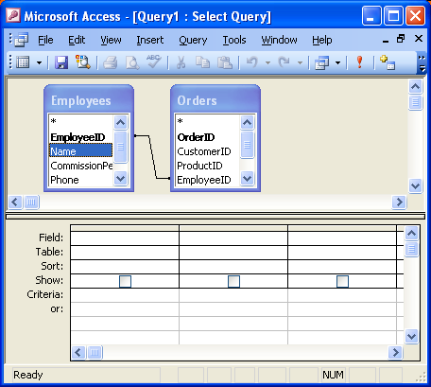
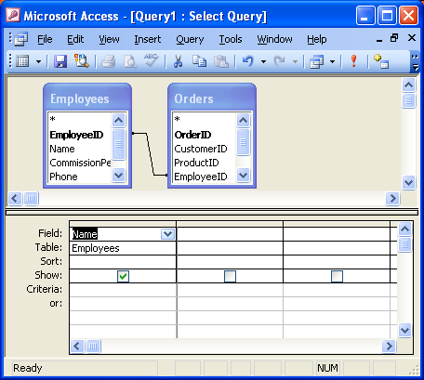
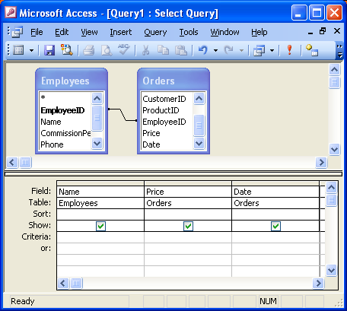
Adding Fields to your Query
add a few more fields
double-click a field to
add it to your query
field is added to your query

Slide 7

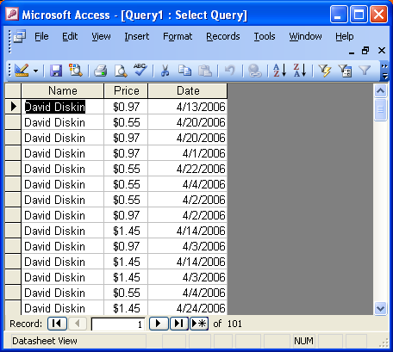
Run your Query
Click this icon to go back to design mode
like a table, you can now see the records
that resulted from your query

Slide 8

Sort and Filter
Use the “Sort” row to specify ways to sort your data. This setting will save with your query for later use.
Use the “Criteria” row to specify which rows should stay. Try any combination of these:
like "*david*"
> 1.25
Between #4/7# and #4/10#

Slide 9
Expressions
Expressions allow you to create new fields (in a query) that are calculated from data in other fields.
The values of an expression are temporary – they are not “saved” anywhere, they only exist when the query is run.

Slide 10
Why Use Expressions?
Modify Text:
  Combine strings together
  See just the first few letters of a string
Calculations:
  Commission
  Tax
  Quantity * Price

Slide 11
Expression Syntax
The calculation.
Name of our
new Expression
A colon (:)

Slide 12
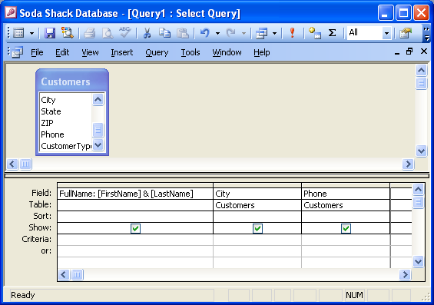
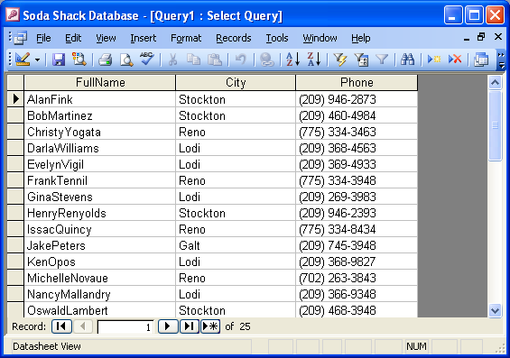
Expressions in Use
When the Query is run, we can see the results of our new Expression. But… oops! We made a minor mistake.
In this query, we have created a new Expression (called “FullName”) that calculates a string based on each record’s First and Last name field.

Slide 13
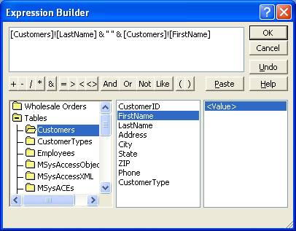
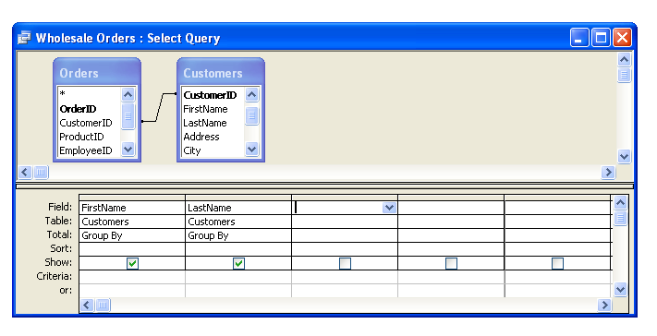
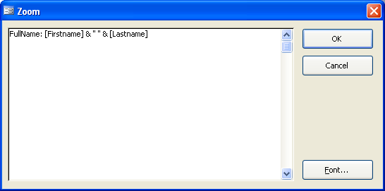
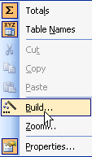
Entering Expressions
Enter directly into Query Builder, or
Build using Expression Wizard
(right click)

Slide 14
Common Expressions
FullName: [FirstName] & " " & [LastName]
Earned: [Price] * [Commission]
Location: [City] & ", " & [State] & " " & [ZIPCode]

Slide 15
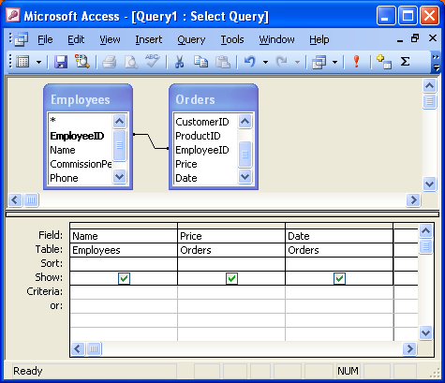
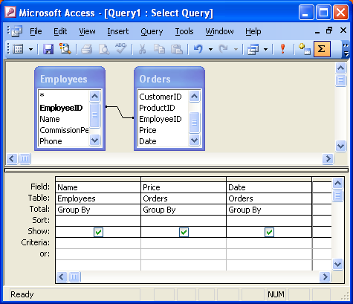
Totals
Total row allows you to group, sum, average, etc…

Slide 16
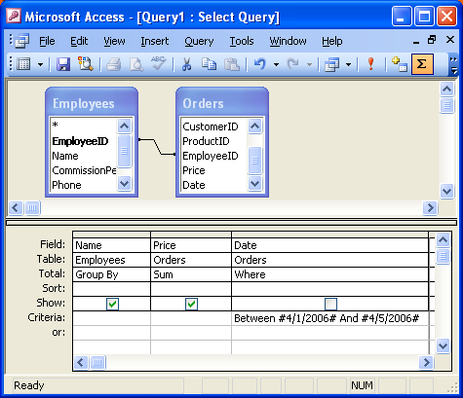
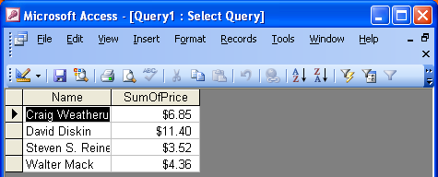
Totals (cont.)
In this query, we are telling Access to group by Employee, and sum the Prices. We’re also filtering only for sales between the 1st and 5th.

Slide 17
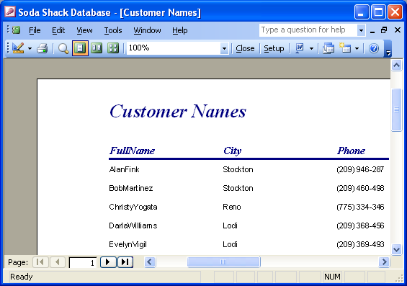
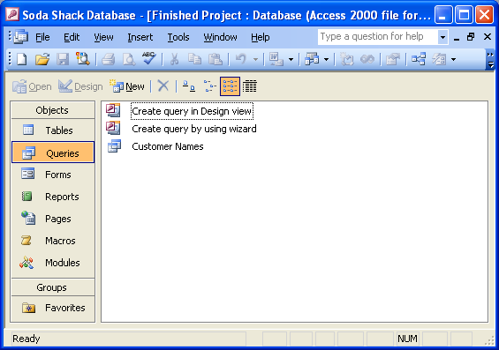
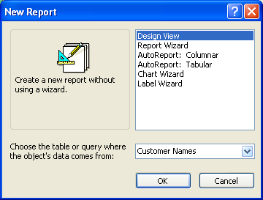
Reports from Queries
After a query is created, it can be used as the source data for a report.

Slide 18
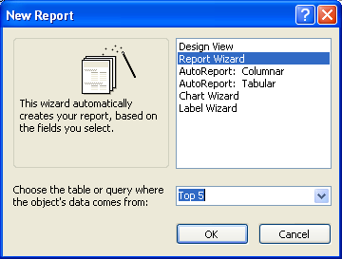
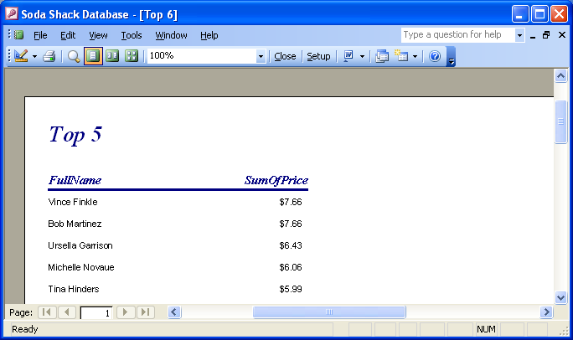
Query to Report

